Slide 1
HR-ANALYTICS
DASHBOARD
Bhavya Mammai

Slide 2
Introduction
Presentation includes the HR Analytics dashboard of ‘ADP’ Organization.
A visual depiction of HR-related data and key performance indicators (KPIs) called an HR (Human Resources) dashboard offers insightful information about numerous facets of a company's personnel.
The specifics of an HR dashboard can change depending on the objectives and priorities of the firm.

Slide 3
Data Abstraction
The dataset is an HR Employee data for the ADP Company.
There are 1470 records in the dataset.
Abstraction:
Employee demographics
Employee satisfaction
Attrition
Count based on education field, department etc.

Slide 4
Task Abstraction
Visualizing the employee data of the organization using different idioms and make HR analysts to understand the data and analyze.
Gender in Company.
Action: Identify percentage number of employees based on gender.
Target: Features
2. Average Age by department and job role:
Action: Compare the average age of employees across different department based on job role.
Target: Distribution

Slide 5
Contd…
3. Attrition By Gender:
Action: To present the rate at which employees are leaving the organization.
Target: Features
4. Gender and Job Role:
Action: Lookup the number of male and female employees in a specified job role.
Target: Distribution

Slide 6
Contd…
5. Gender and Marital Status:
Action: Derive the marital status based on gender.
Target: Features
6. Number of Companies Worked for:
Action: Present the number of employees with previous experience.
Target: Similarity

Slide 7
Contd..
7. Total employees by Education Field:
Action: Summarize the number of employees in different education field.
Target: Features
8. Job Satisfaction Rating:
Action: Compare job satisfaction rating with different job roles.
Target: Correlation

Slide 8
Contd….
9. Average Monthly Income By Department and Job Role:
Action: Compare the average monthly income of employees of different job roles of a department.
Target: Dependency
10. Total Employees By Department and Job Role:
Action: Summarize the number of employees in a job role of a department.
Target: Trends

Slide 9
Workflow Diagram
Collecting the data
Analysing the data
Creation of dashboard of HR analytics
Creation of Home page of Organization
Making the home page interactive with dashboard
Analysing the results

Slide 10
Implementation using tools
Tableau
Visualizations of employee data
D3.js
Creation of webpage

Slide 11
Result
The resultant webpage :
ADP-DASHBOARD

Slide 12
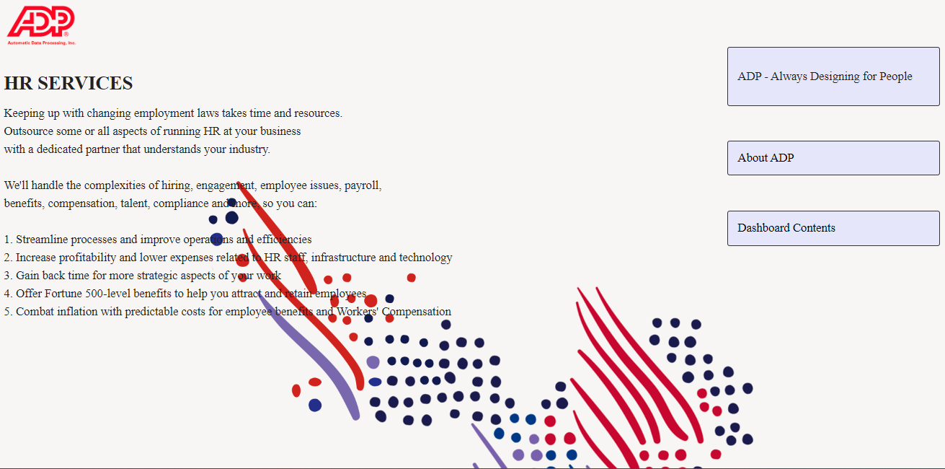
The HR Services page:
This is the HR services page when the adp.html code is ran the webpage now contains an HR page where there can be hr resources used.

Slide 13
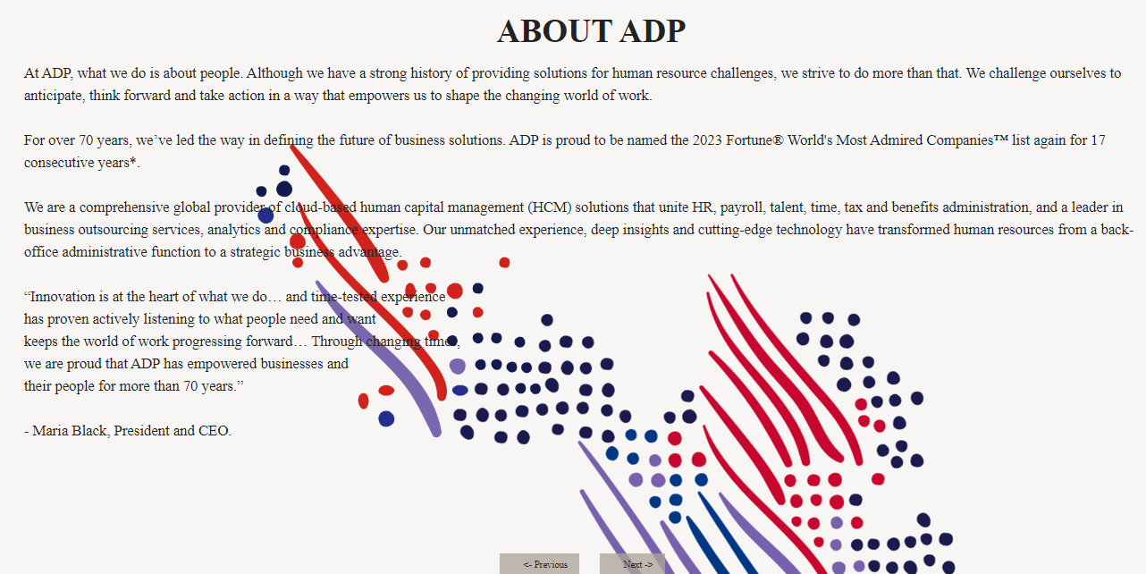
The about page:
This is the about page. When the additional about.html code is ran it gives the additional option to read about the company the data covers.

Slide 14
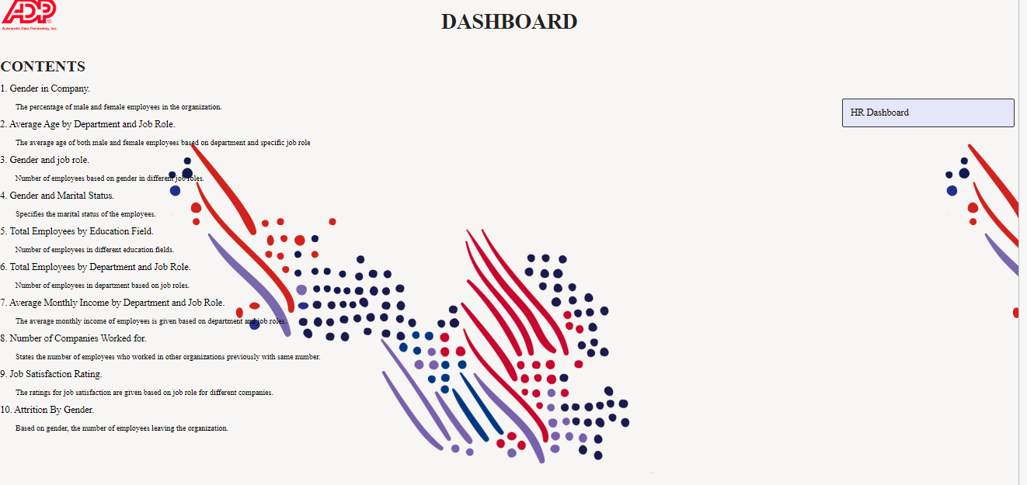
The Home Page:
When the html link is ran, this is the webpage that is created. It is a homepage for the dashboard with contents and a link to the HR dashboard.

Slide 15
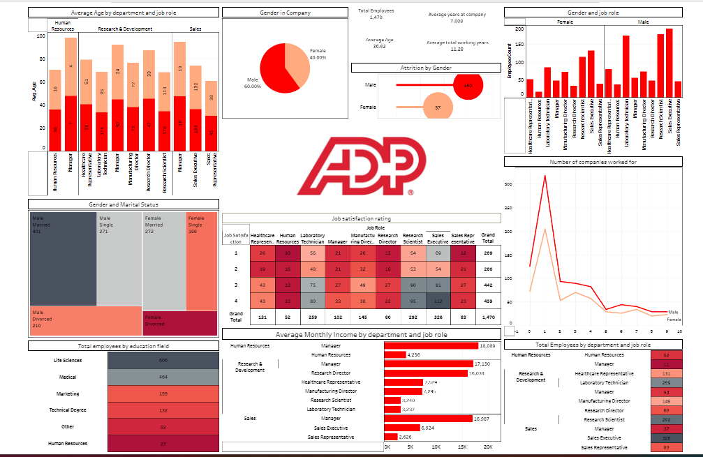
Results and Analysis: The Dashboard

Slide 16
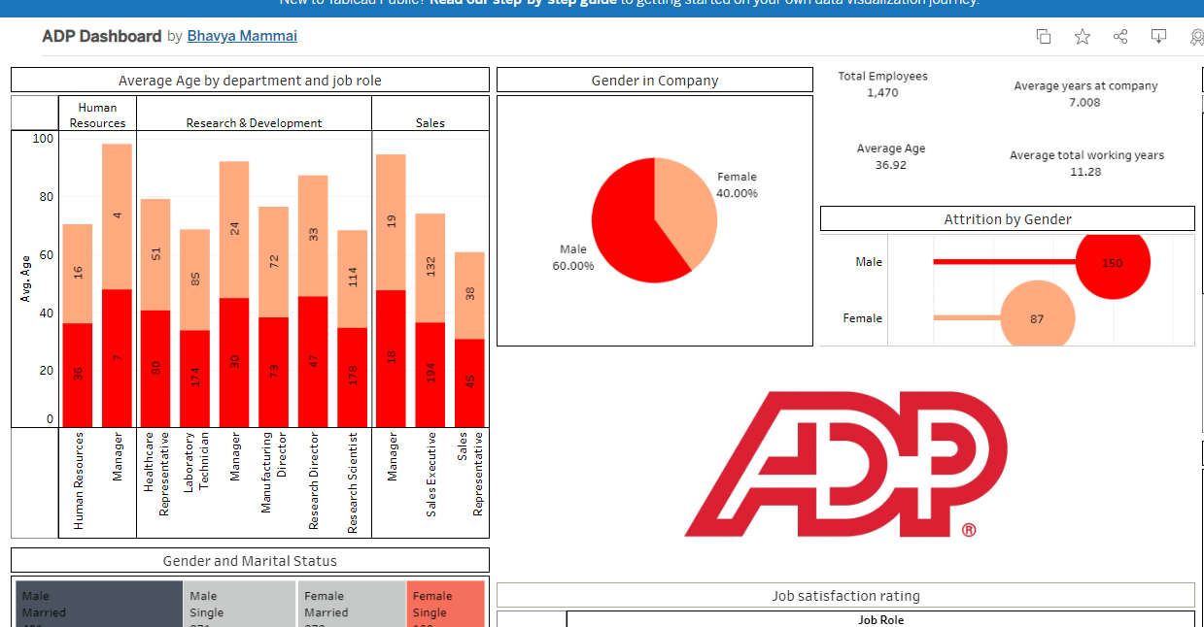
The Visuals

Slide 17
1st quadrant explained:
This is the first quadrant of the dashboard.
It has a stacked bar chart
Representing average age by department and job role
A pie chart
Representing the genders in the company and its diversity.
Schematic chart
Representing the attrition by gender

Slide 18
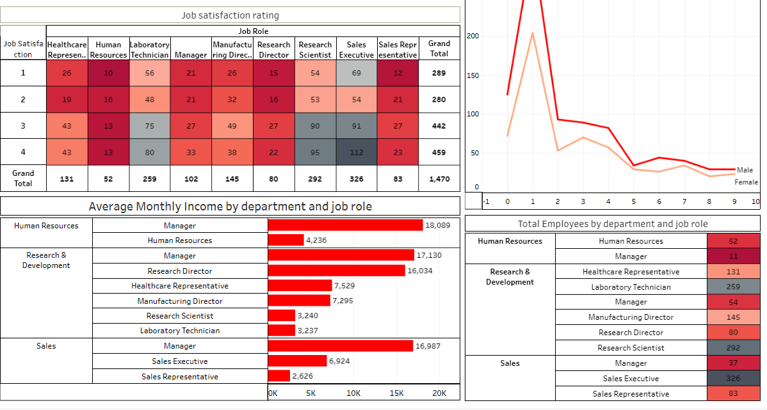
The Visuals cont…

Slide 19
2nd Quadrant Explained:
This is the 2nd quadrant of the dashboard.
It has a line chart
This shows the number of companies each person has worked for and is broken down by gender
Horizontal bars
This breaks down the monthly income by the department and job role
A detailed list
Shows the employees by department and job role
A box chart(highlight tables)
Gives a visual of the number of people in each position and their satisfactory rating

Slide 20
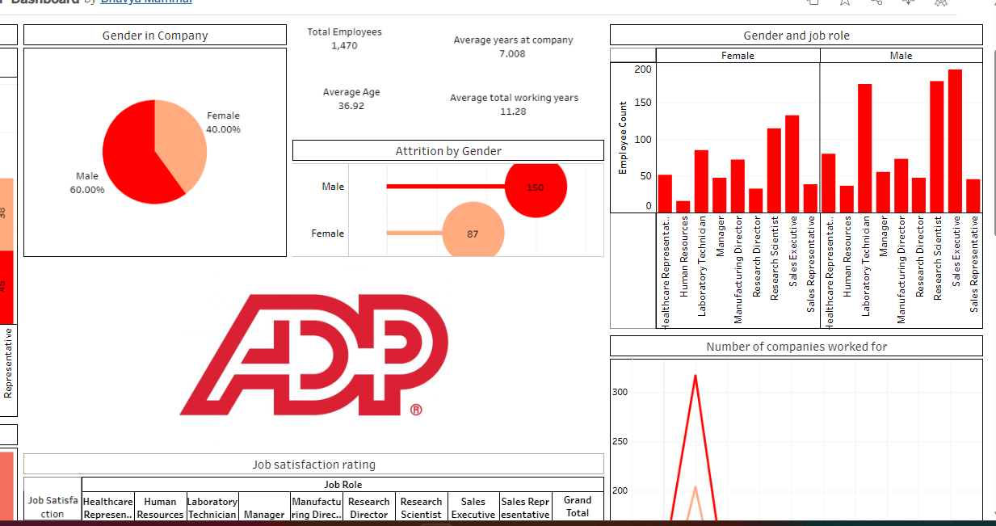
The Visuals cont…

Slide 21
The 3rd quadrant explained:
This is the 3rd quadrant of the dashboard:
This quadrant includes:
The same schematic diagram
The same pie chart
And a vertical bar chart
Representing the gender and job roles

Slide 22
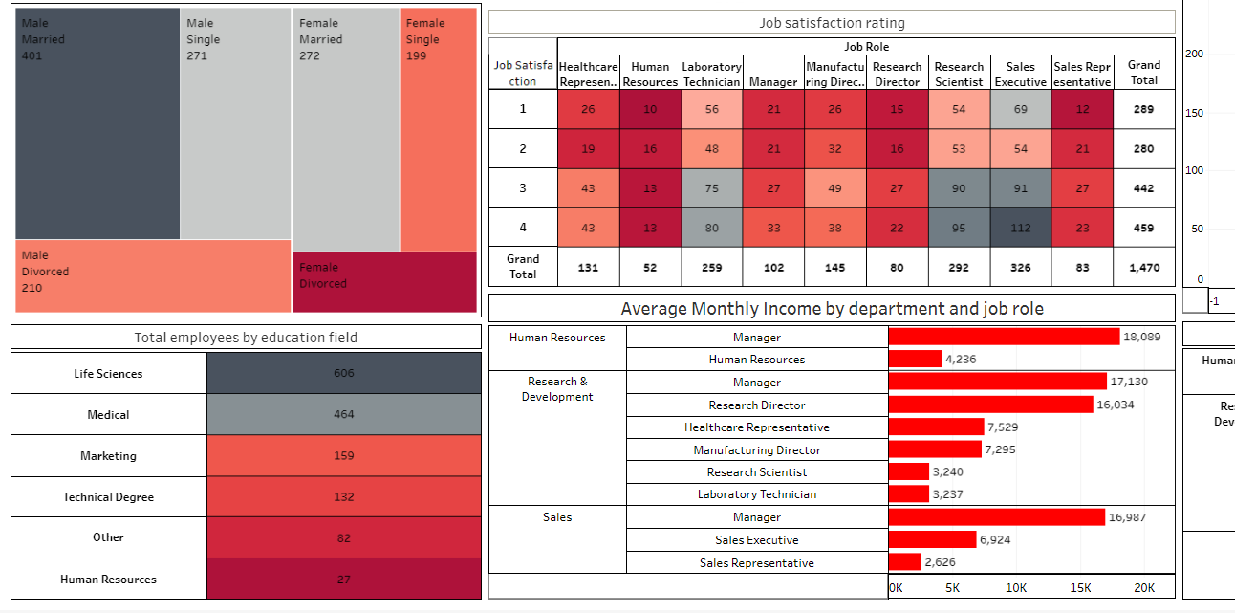
The visuals Cont..

Slide 23
The 4th quadrant explained:
This is the 4th quadrant:
It contains:
The same box chart (highlight tables) diagram
The same horizontal bars
A color bar list
This represents the total employees by each education field
A visual categorical spread
Tree-Map diagram
This shows the number of males and females in each marital status

Slide 24
References/Bibliography
Tamara Munzner data visualization book - https://www.cs.ubc.ca/~tmm/vadbook/
Dashboard - https://www.tableau.com/dashboard-examples
Tableau provides a sample HR analytics dashboard that highlights important HR KPIs, employee demographics, and attrition information. It illustrates how interactive capabilities in Tableau may be used for data exploration. Internet address:
https://public.tableau.com/app/discover/viz-of-the-day

